Slide 1

MITRE ATT&CK FRAMEWORK

Slide 2
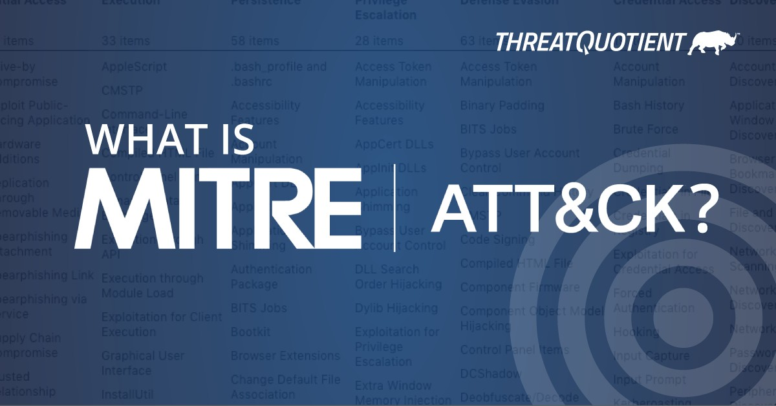


Slide 3


WHAT IS MITRE ATT&CK ?
It is the most up-to-date information center showing the b ehavioral anatomy
of an attack.
It was formed by observing attacks that occurred in the real world.
Take a Test
It is based on tactics, technique and procedure.
It is a free, open and accessible information center.
Fix gap
Find gap

Slide 4
Understanding "ATT&CK"
ATT&CK stands for adversarial tactics, techniques, and common knowledge.
TT>Tactics and Techniquies is a modern way of looking at cyberattacks. Rather than looking at the results of an atack,aka an indicator of compromise(IoC), security analysts should look at the tactics and techniquies that indicate an attack is progress. Tactics are the why of an attack techniquie. Techniques represent how an adversary achieves a tactical objective by performing an action.
CK>Common Knowledge is the documented use of tactics and techniques by adversaries. Essentially, common knowledge is the documentattion of procedures. Those familiar with cybersecurity may be familiar with the term "tactics, teechniques, and procedures", or TTP.

Slide 5
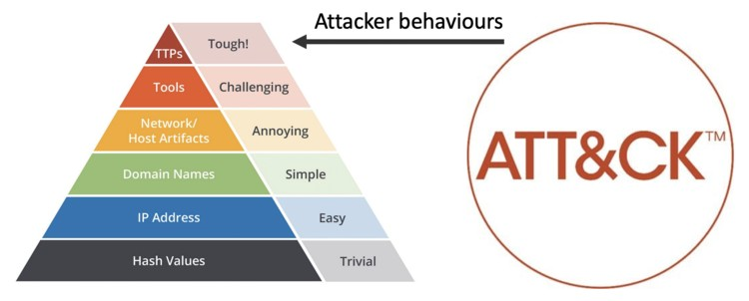
"Not enough to manage incidents, kickoff to think to manage adversaries"
John Lambert, Security Influencer

Slide 6
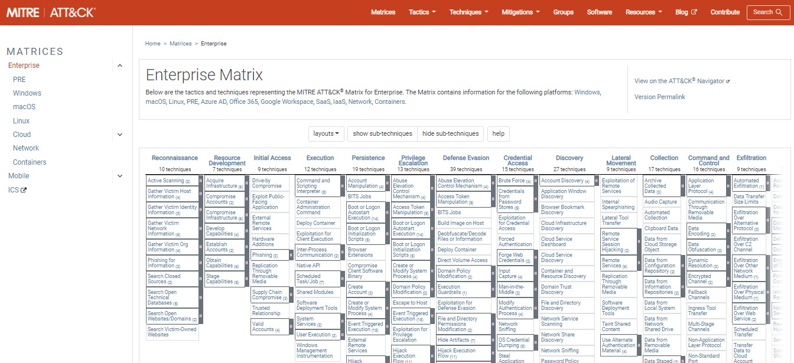


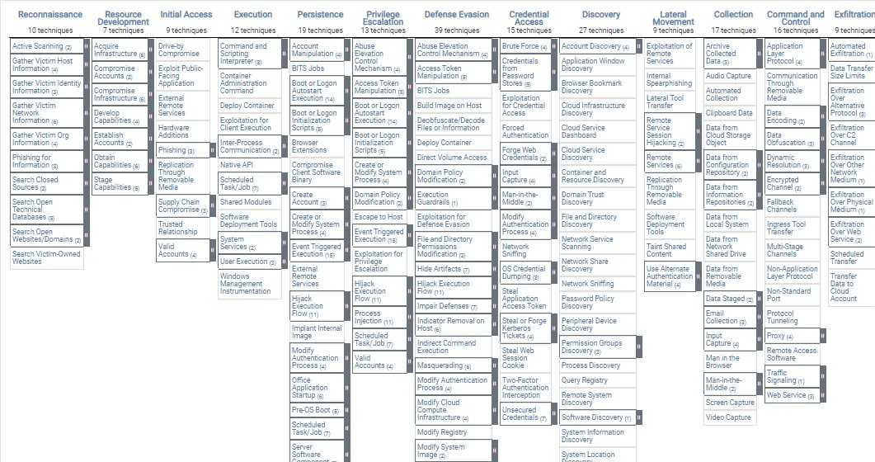

Slide 7
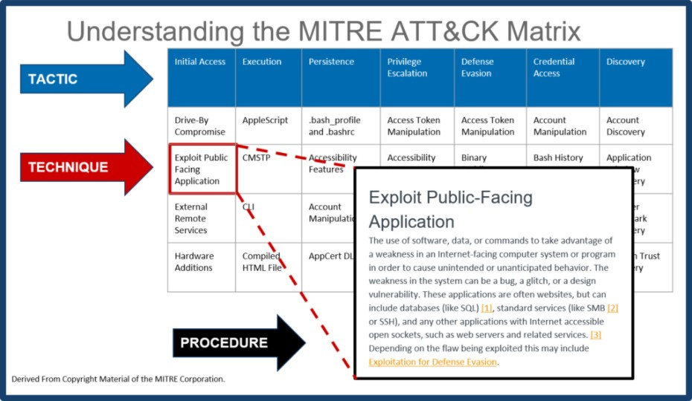

Slide 8
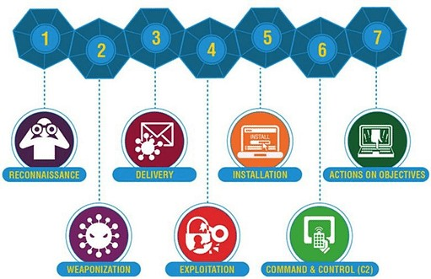
What is the Cyber Kill Chain?

Slide 9
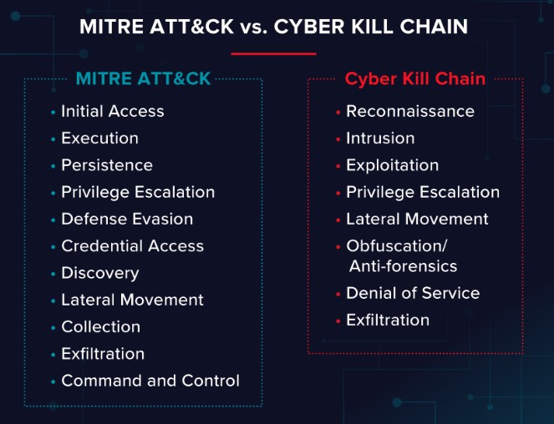

Slide 10
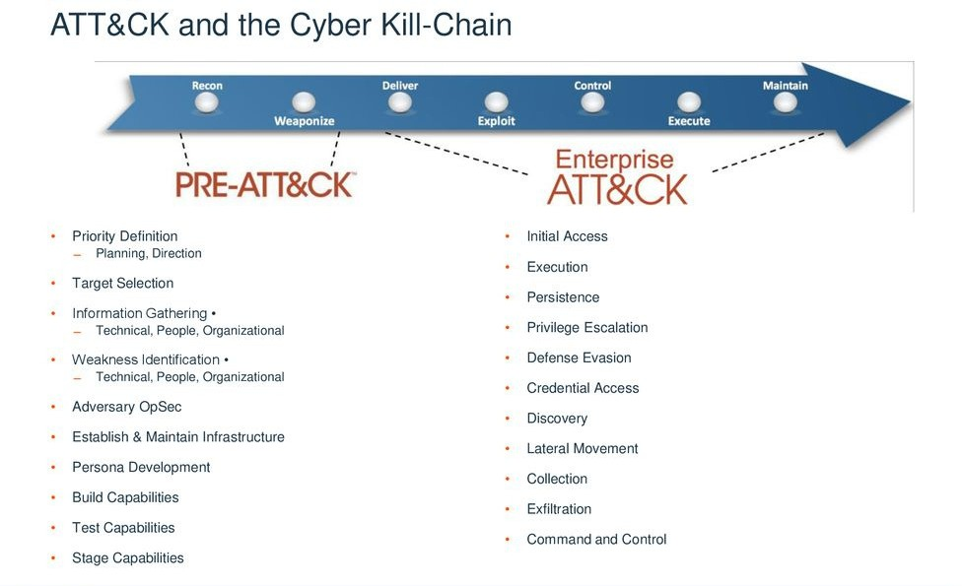

Slide 11
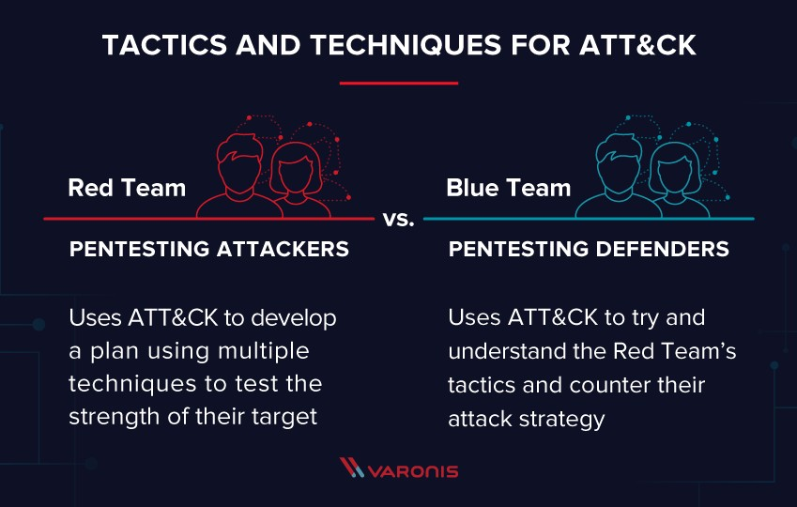

Slide 12
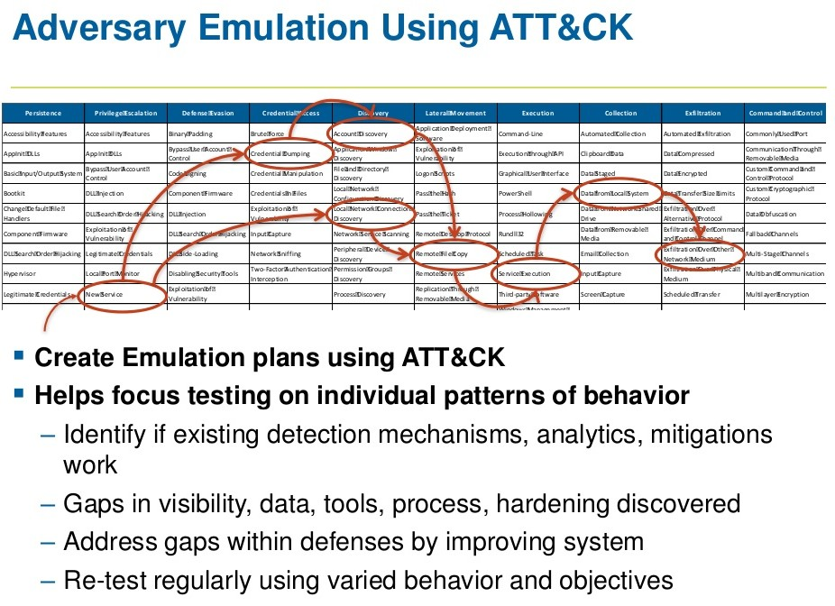
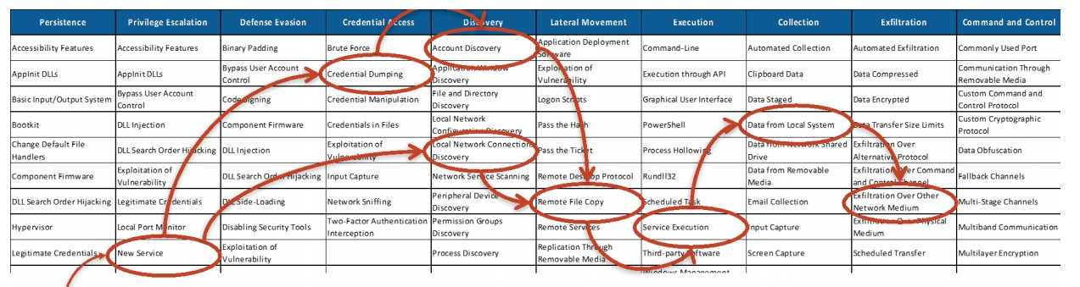
ATT&CK Use Case

Slide 13


ATT&CK Use Case
Red Teaming
It is real attack. It's not a scenario.
It is carried out without the use of known Cyber intelligence.
It is carried out until the last phase of the Cyber Kill Chain.
Breach does not deal with the part of the effect related to the evaluation of the effect that has occurred or the defensive system.

Slide 14




ATT&CK Use Case
Behavioral Analytics Development
It is an R&D subject that enables the detection of potentially malicious or suspicious activities within systems or network based on traditional IOC data, malicious activity signature sets and heuristic behavior detection models.
ATT&CK is a tool for managing and testing behavior analytics.
Behavior Analytics are carried out to strengthen detection mechanisms.

Slide 15
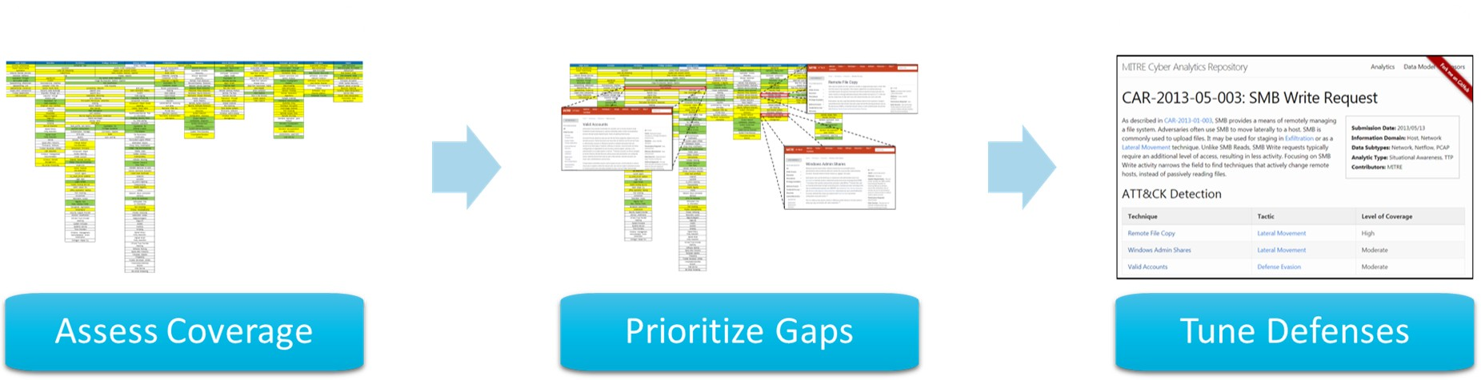

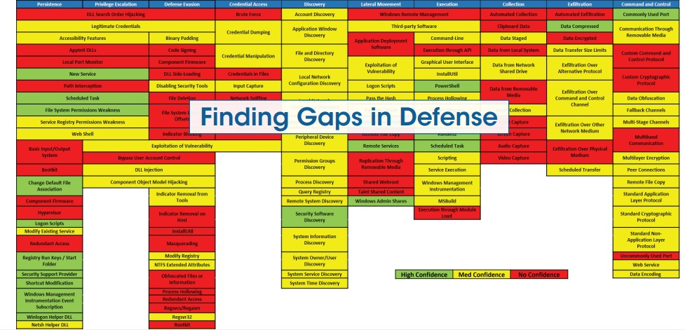


ATT&CK Use Case
Defensive Gap Assignments
"It is an assessment management that allows to identify the missing parts of the defense system and visibility."
It provides evaluation with defense glasses.
It reveals points in the network where attackers cannot be detected and mitigated.
It allows to see breaches that the attacker can potentially gain access to.

Slide 16
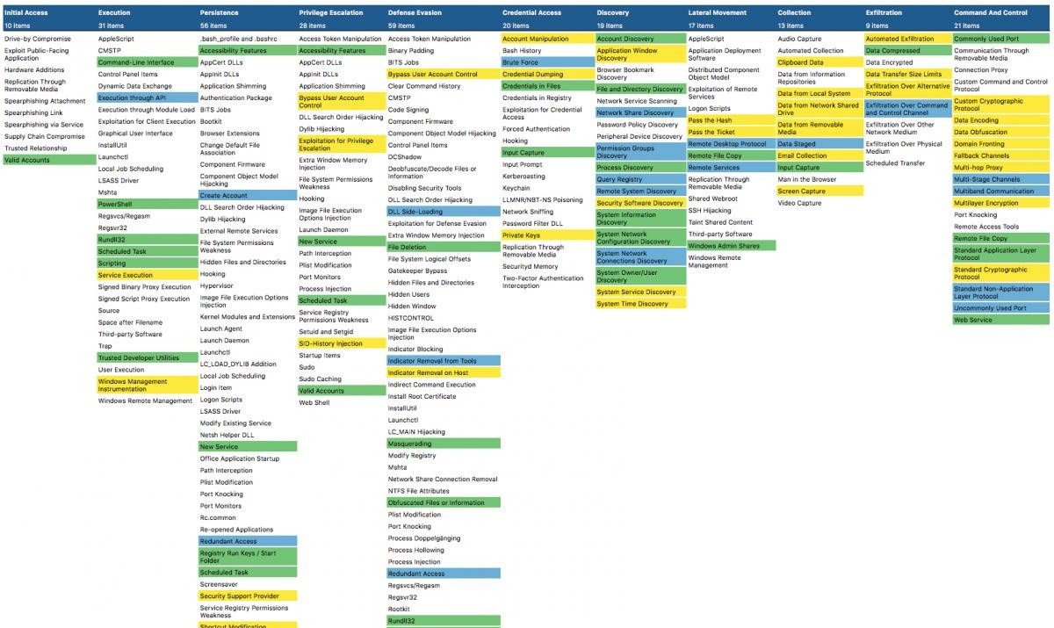
ATT&CK Use Case
SOC Maturity Assessment
SOC is a tool effectiveness of
that
measures the
as and
processes such
detecting, responding ATT&CK.
analyzing,
to cyber threats within
responding,

Slide 17
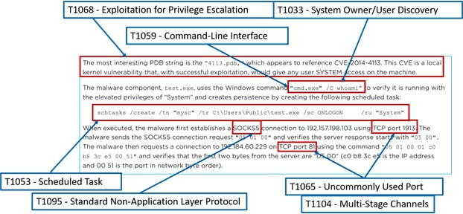
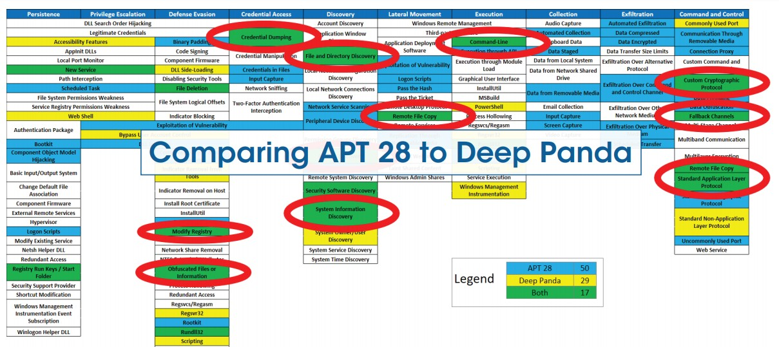
ATT&CK Use Case
Cyber Threat Intelligence
It is a body of information that includes
the impact and risks of cyber threats and threat groups on cybersecurity in a wide spectrum.
ATT&CK provides temperature maps of different techniques used to give the procedures of APT groups (ATT&CK Navigator)
Intelligence allows the data to be given as a procedure that includes the behavior of the attackers.

Slide 18

THANK YOU FOR LISTENING !
Hatice ARSLANHAN | 15030461001
Derya SAHA | 16030211014
Mehmet Sait ALTINTAŞ | 17030411048

